Slide 1
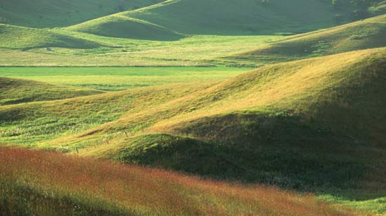
Meet the Monocots

Slide 2
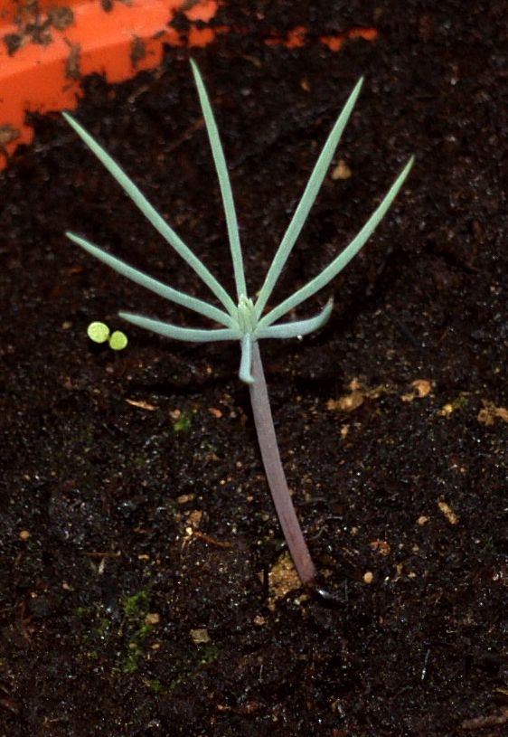
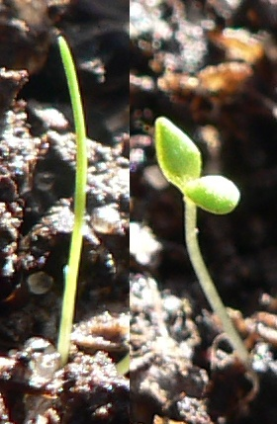
Cotyledons
“Seed leaves”
Produced in the embryo
Different structure to “true” leaves
Gymnosperms
2-24 cotyledons
Angiosperms
1 or 2 cotyledons
Monocot
Dicot
By Sternenlaus, CC BY-SA 3.0, https://commons.wikimedia.org/w/index.php?curid=4764892
By: Pengo - Peter HalaszCC BY-SA 3.0, https://commons.wikimedia.org/w/index.php?curid=837422

Slide 3
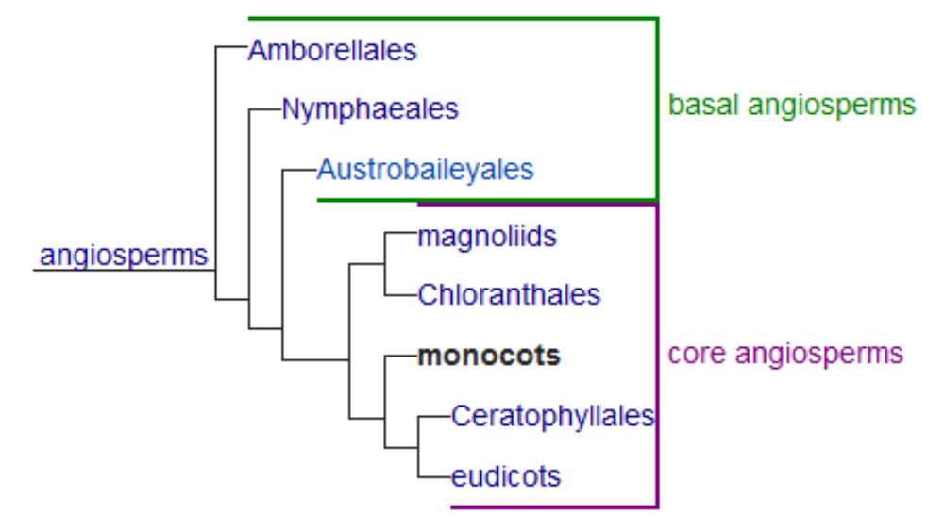
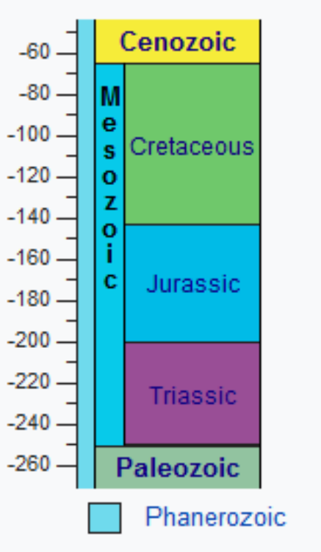
The Monocots
~135MYa

Slide 4

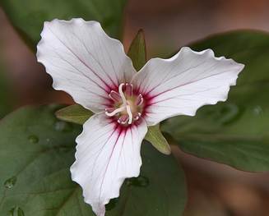
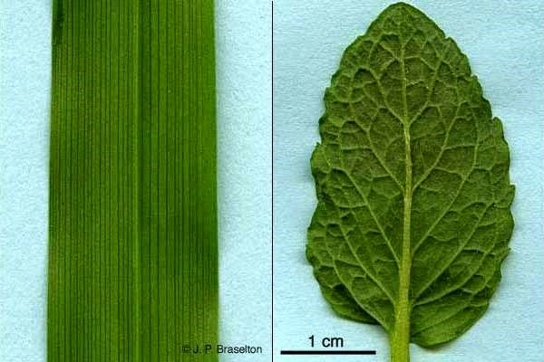
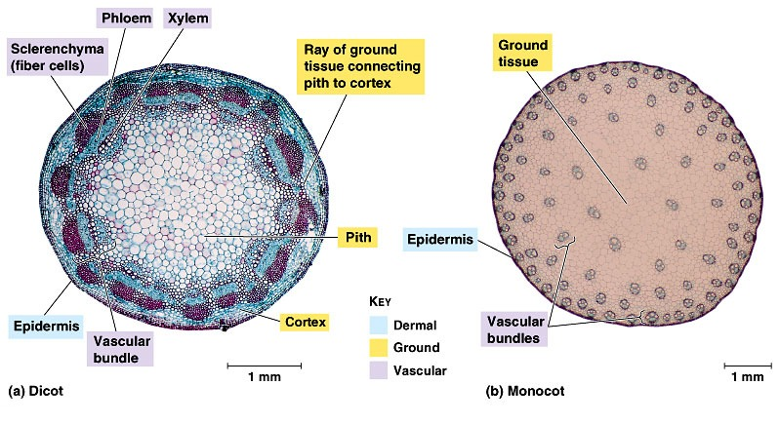
How to Spot a Monocot…
Flower with 3-fold symmetry
“Single cotyledon”
Parallel veins
Scattered vascular bundles
Monocot
Dicot

Slide 5
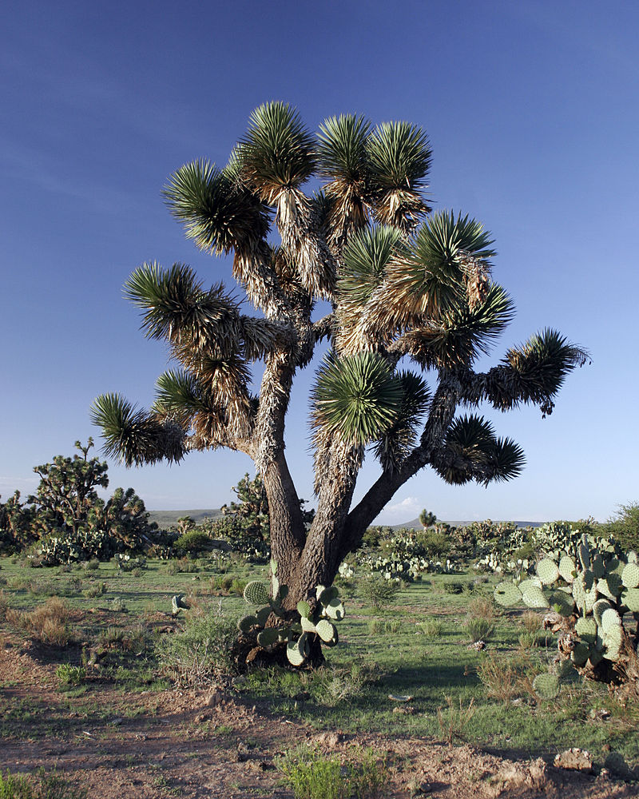
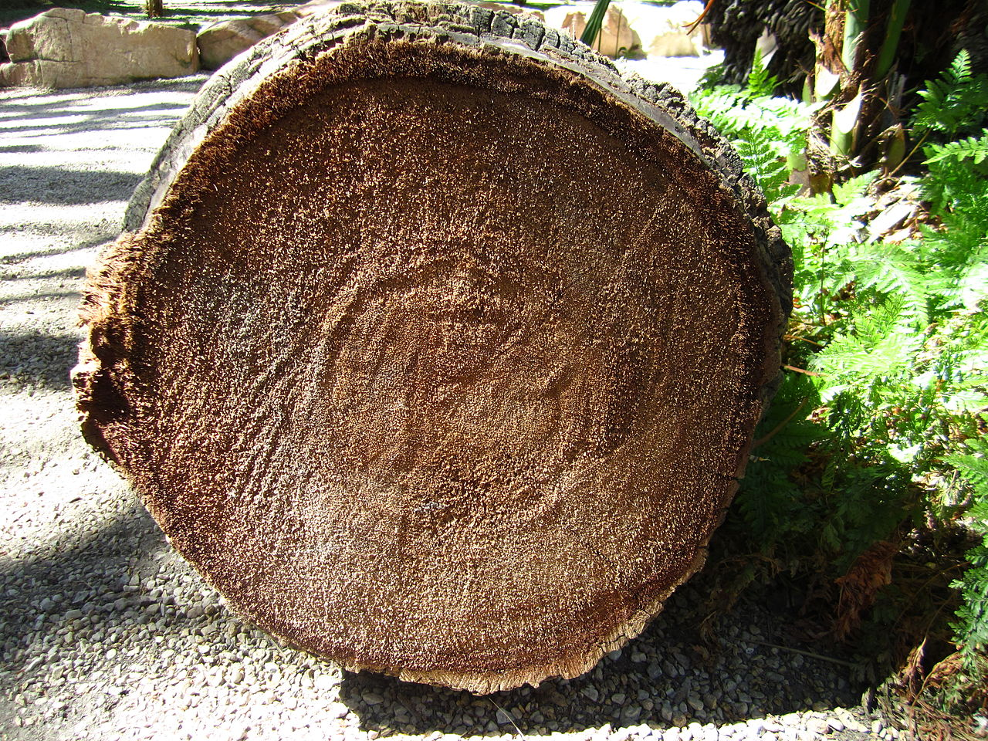
Monocot meristems
Meristem - point of cell division
Apical meristem – at tip
Lateral meristems – allow stems to growth thicker
Monocots lack lateral meristems
So cannot form wood
By Tomas Castelazo (Own work) [CC BY-SA 2.5 (https://creativecommons.org/licenses/by-sa/2.5)], via Wikimedia Commons
(By Kadeve - Own work, CC BY-SA 3.0, https://commons.wikimedia.org/w/index.php?curid=21478125)

Slide 6
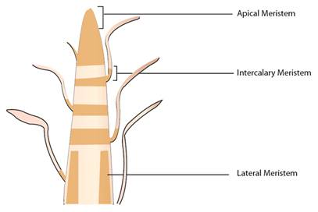
Monocot meristems
Monocots have intercalary meristems
Leaves can grow from base up

Slide 8
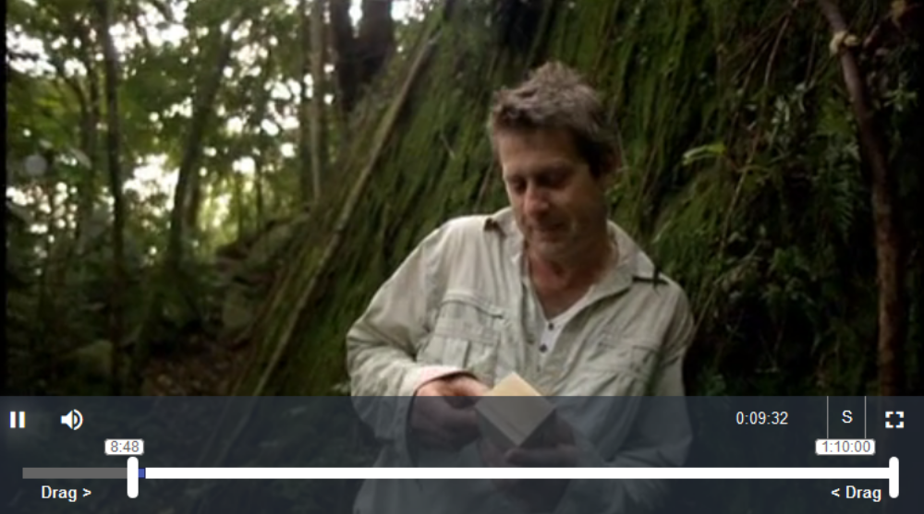
https://learningonscreen.ac.uk/ondemand/index.php/clip/106709
2:20

Slide 10
Enter the Grasses

Slide 11
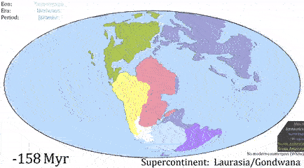
The Paleogene (66 – 23 MYa)
Dinosaurs dead
Mammals became dominant
Cooler drier climate

Slide 12
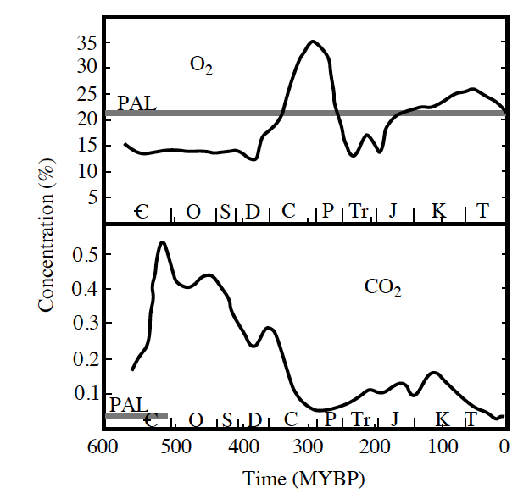
A change of atmosphere?
Falling CO₂ resulting from mountain building

Slide 13
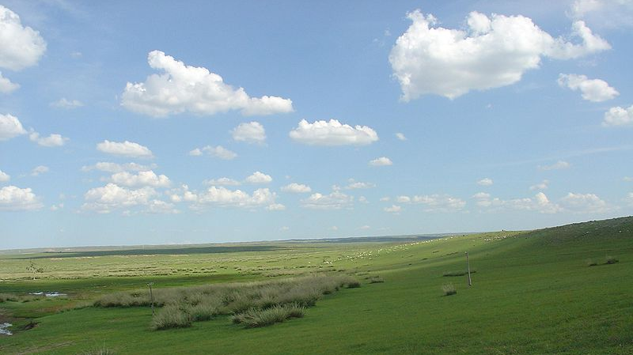
The Rise of the Grasses
Grasses short
Grazing tolerant
Fire tolerant

Slide 14
The Rise of African Grasslands
~20MYa – Africa collided with Eurasia
Proboscidea (elephant relatives) spread out
Bovidae moved in
Trees decline – grasses and thorny bushes increase
Video: https://www.futurelearn.com/courses/extinctions-past-present/0/steps/24693
Paper (more technical): https://www.pnas.org/content/113/38/E5572

Slide 15
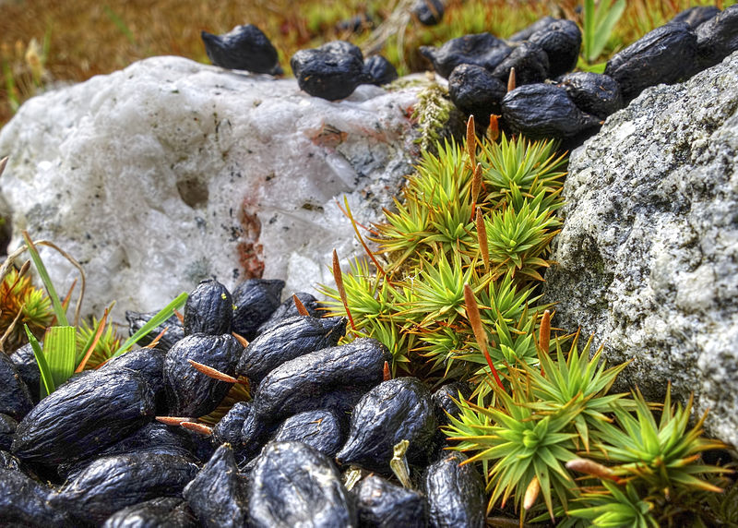
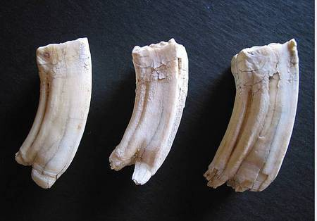
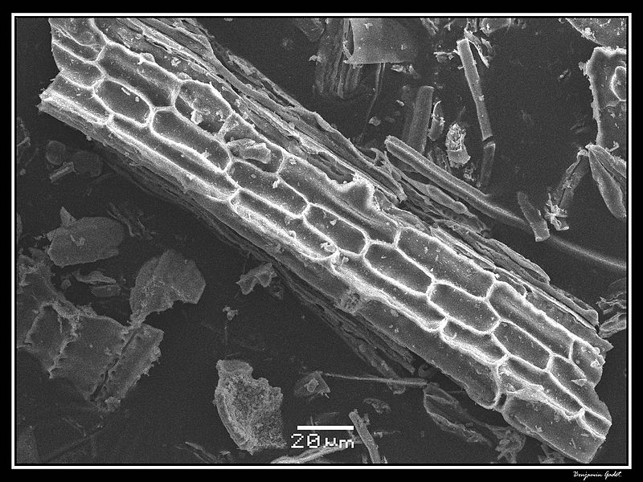
Eating Grass
Phytoliths: silica crystals formed by plants
Co-evolution of herbivores

Slide 16
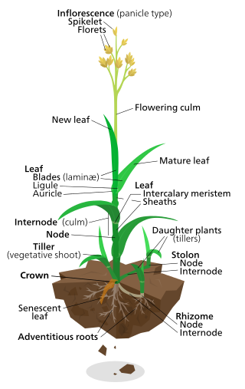
Grasses Grow from the Bottom Up

Slide 17
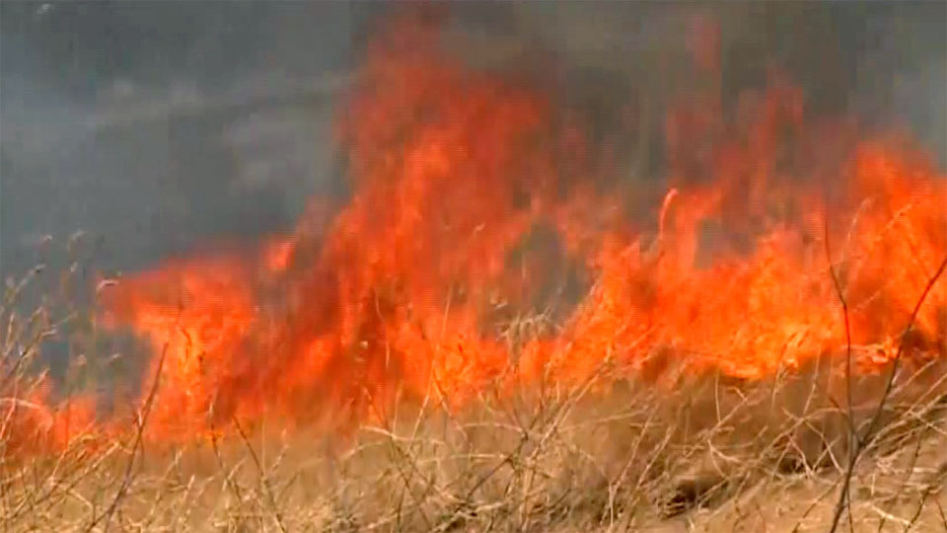
Grass Fires
https://learningonscreen.ac.uk/ondemand/index.php/clip/32212
7:30

Slide 18
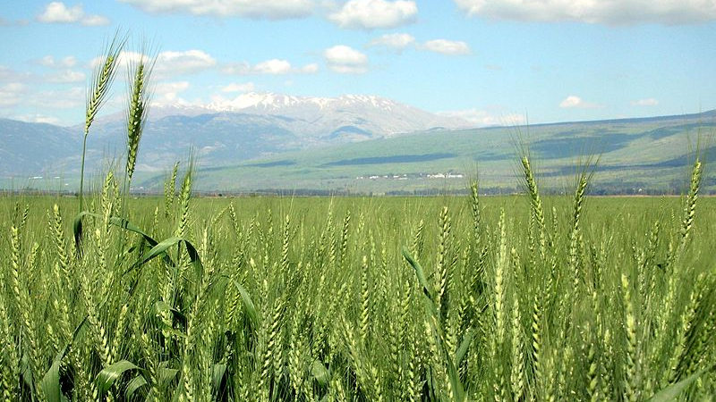

EART11100
How to Grow a Planet
Fields of Joy

Slide 19
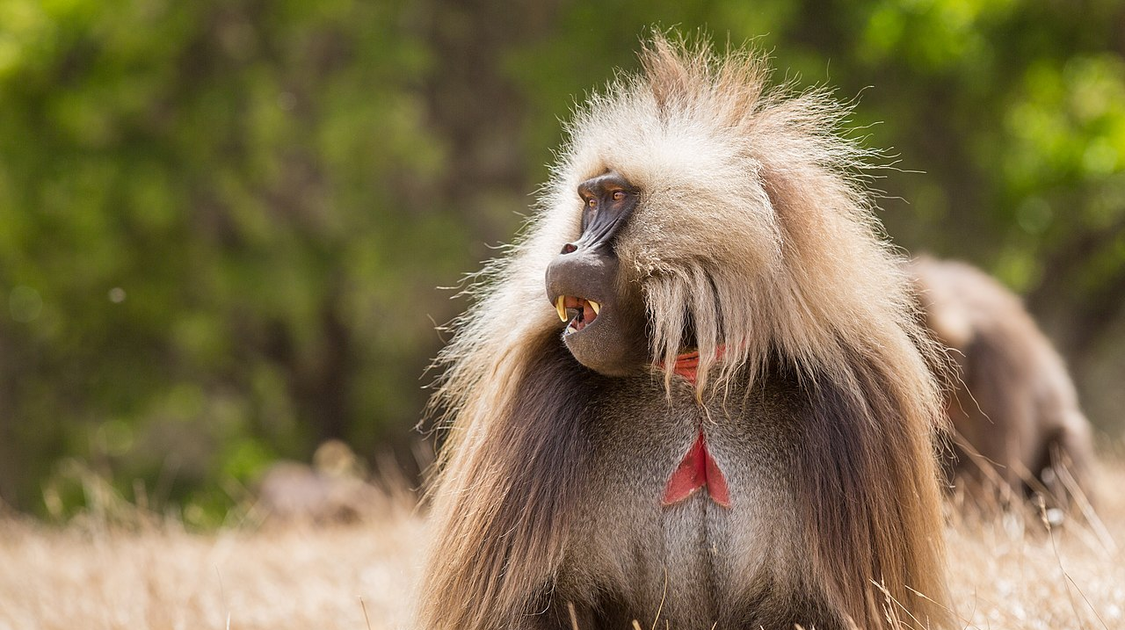
Theropithecus gelada
By Geertchaos - Own work, CC BY-SA 4.0, https://commons.wikimedia.org/w/index.php?curid=77060831

Slide 20
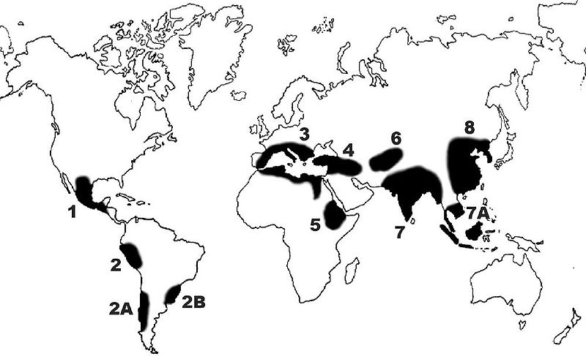
Origins of Agriculture
Occurred across the world ~12-10 KYa – Why?
Rice
Maize
Wheat
Barley

Slide 21
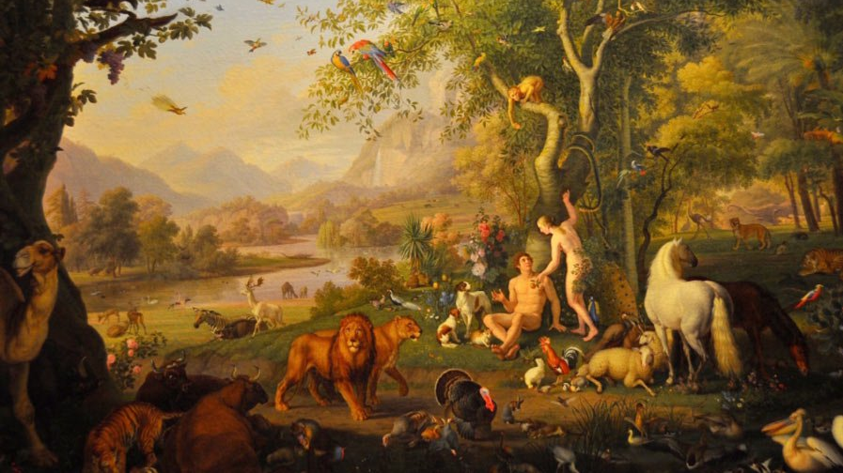


Slide 22
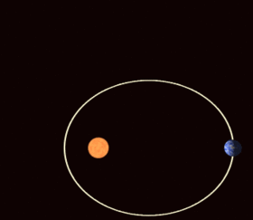
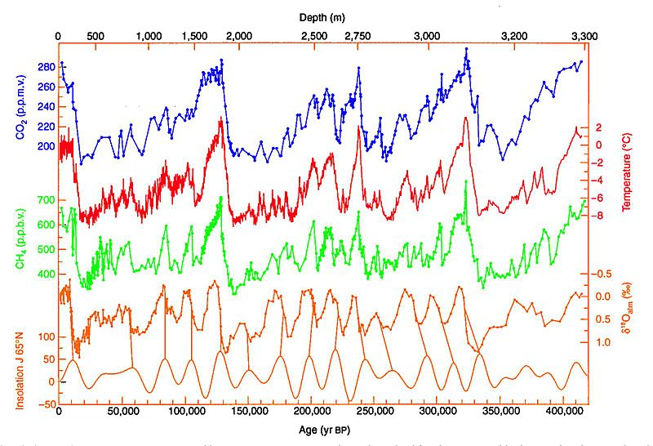
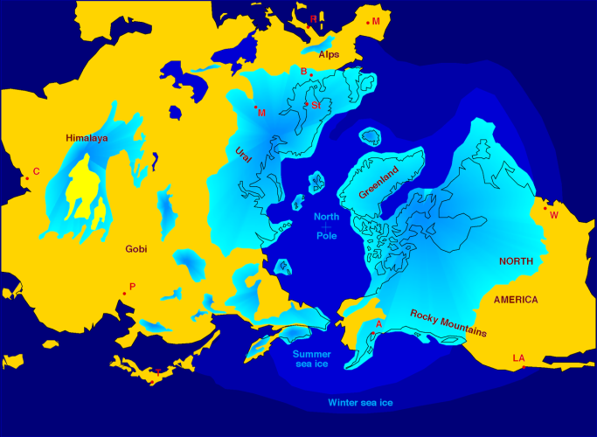
Milankovitch cycles
Irregularities in Earth’s orbit – solar radiation varies
~130 Ky cycle

Slide 23
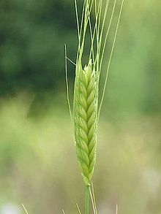
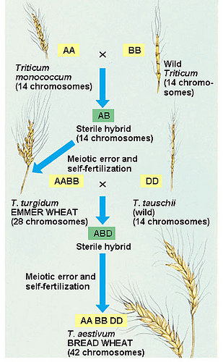
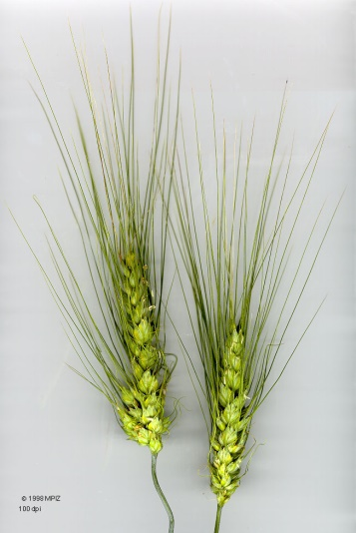
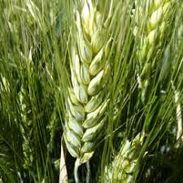
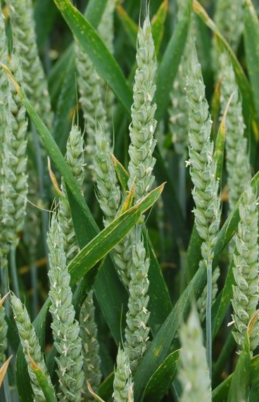
Evolution of Bread Wheat
Einkorn
Hybridisation
Emmer
Genome duplication – new species!
2nd Hybridisation - duplication
Durum – pasta
Bread wheat - hexaploid

Slide 24
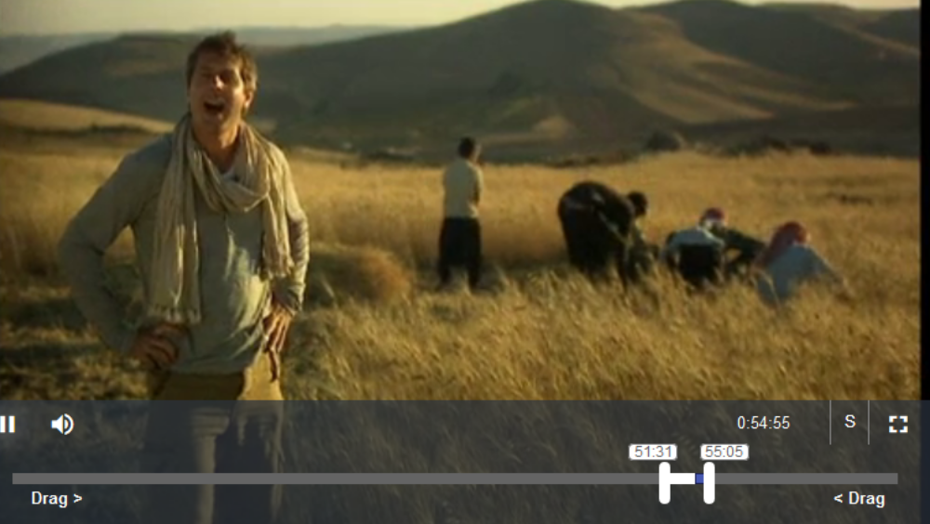
Graminivore Apes
Video on BoB 3:30
Non-shattering phenotype
Also try reading this review - http://science.sciencemag.org/content/316/5833/1830.full

Slide 25
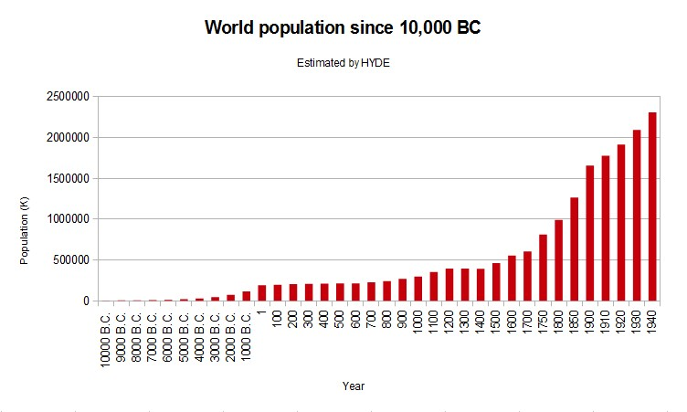
Current population 7.8 Billion

Slide 26
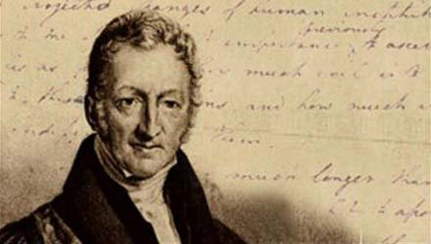
Thomas Malthus
An Essay on the Principle of Population
(1789)
That the increase of population is necessarily limited by the means of subsistence,
That population does invariably increase when the means of subsistence increase, and,
That the superior power of population is repressed by moral restraint, vice and misery

Slide 27
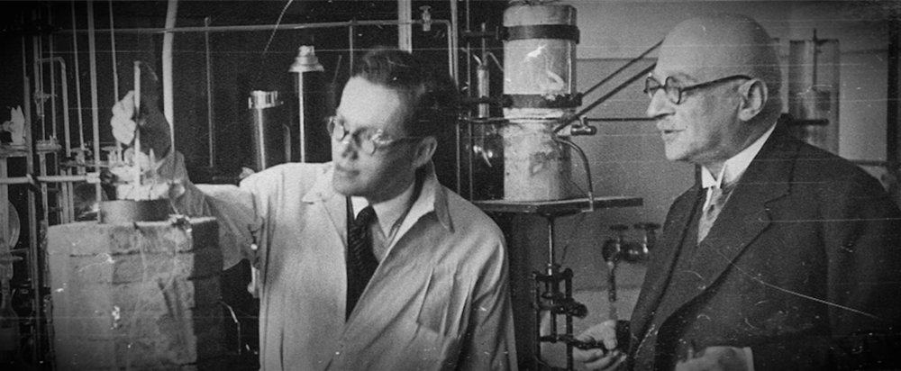
Haber Process
Fritz Haber and Carl Bosch
N₂ + 3H₂ → 2NH₃
∆H = -91.8 kJ .mol⁻¹
Very energy expensive

Slide 28
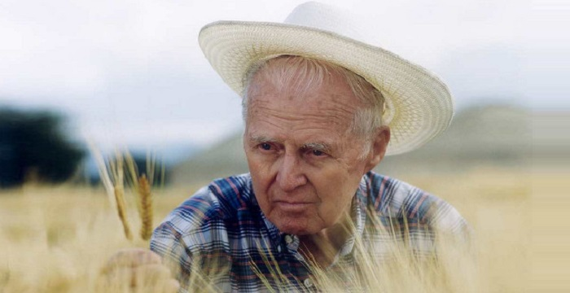
Norman Ernest Borlaug
1914-2009
Father of the ‘Green Revolution’
Nobel Peace Prize 1970

Slide 29
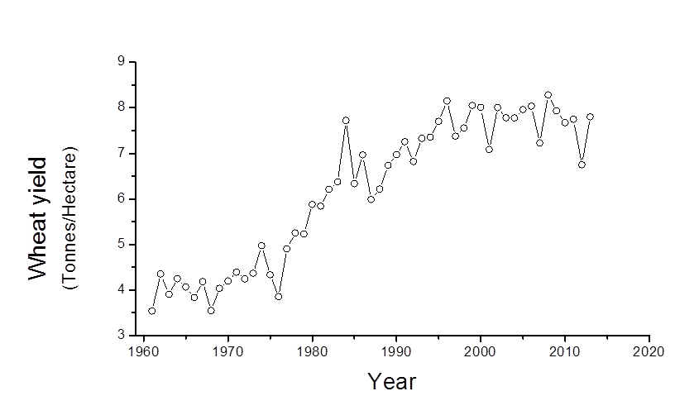
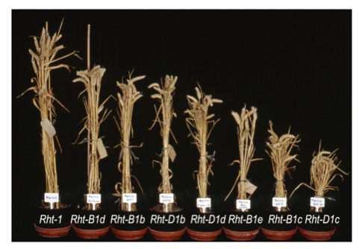
Dwarf Varieties
New Maximum
Requires chemicals
Shorter plants = higher harvest index
(harvest index = grain/total plant)
also - less lodging (falling over)
So higher yields

Slide 30
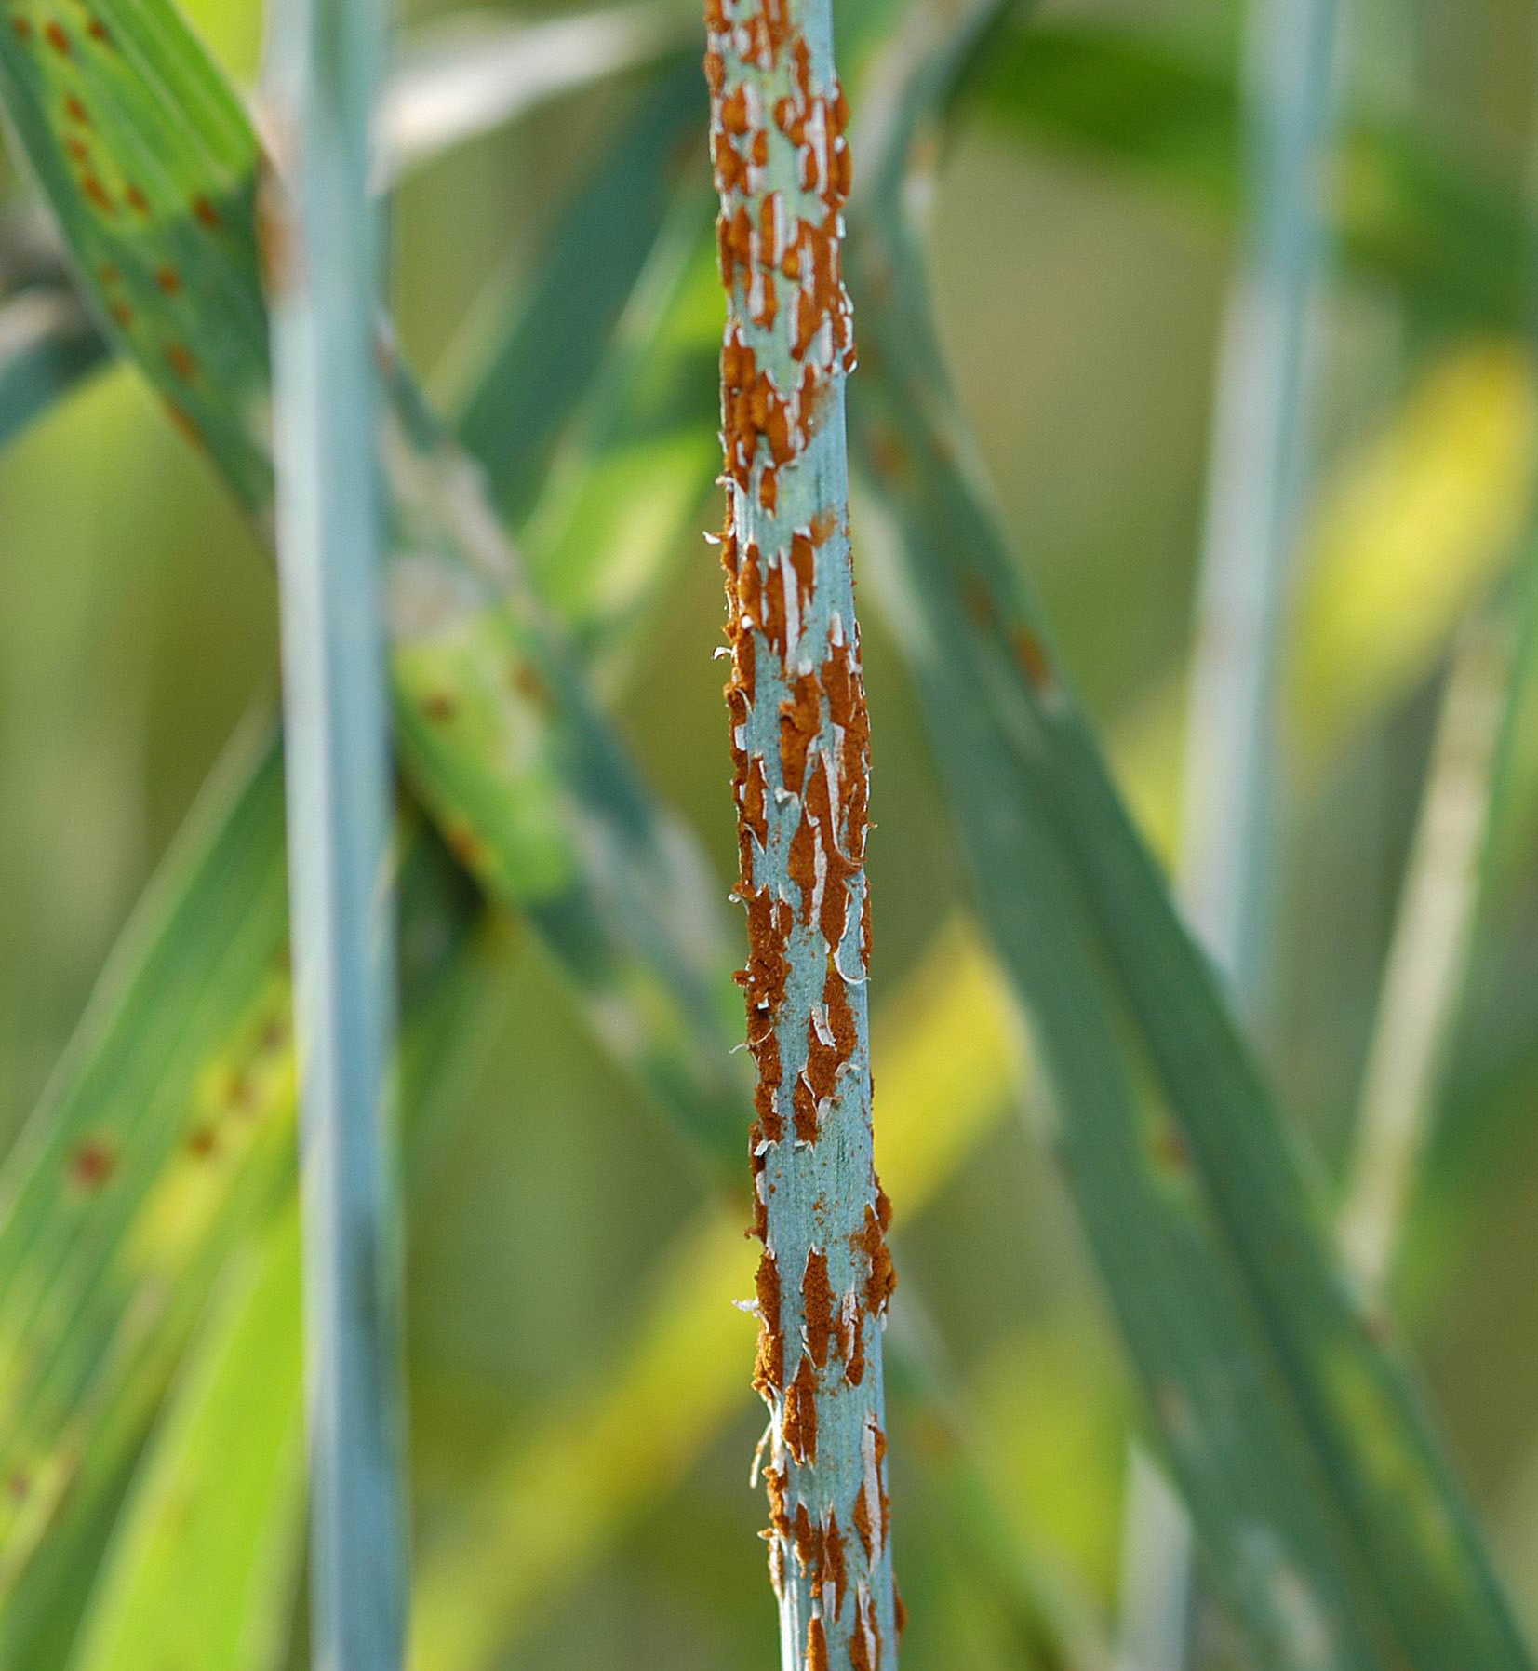
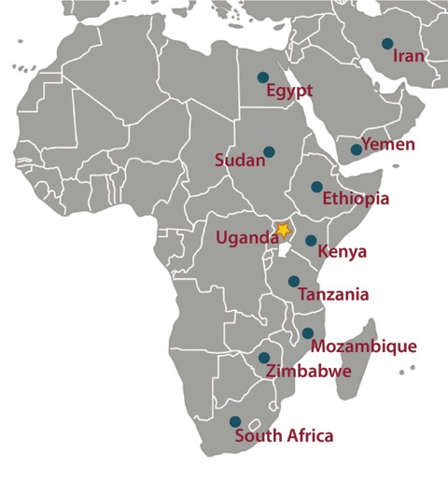
Wheat Stem Rust – Puccinia graminis
Rust reduces crop yields
Plant breeding produced resistance
New rust variety able to infect wheat crops in Africa
Thanks to Aleana Cairns

Slide 31
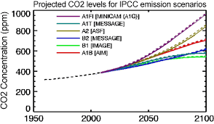
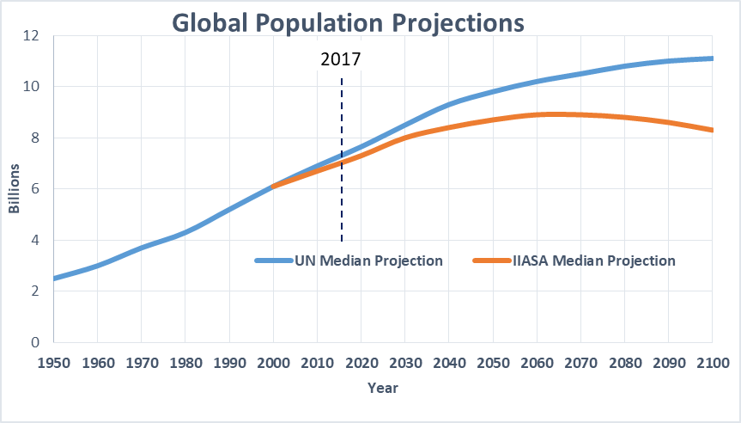
A changing world

Slide 32
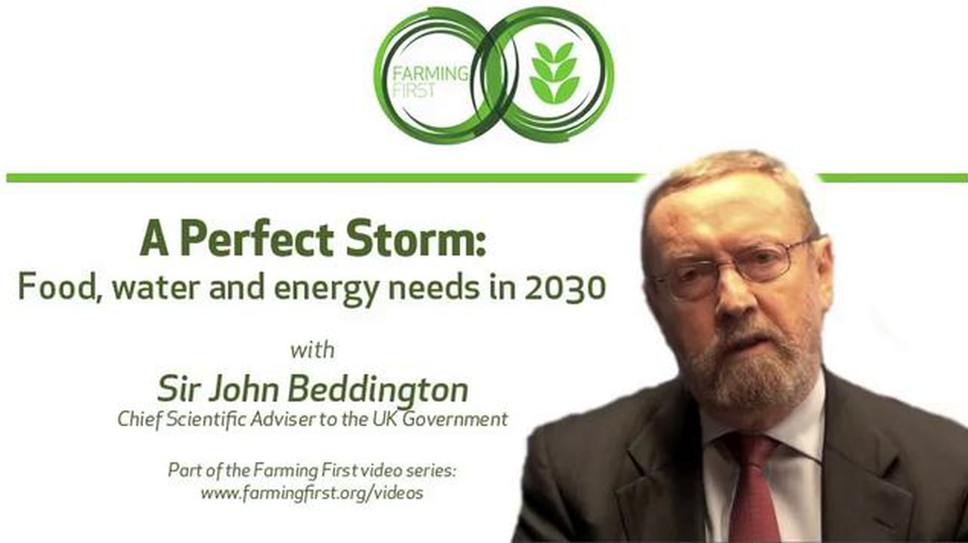
A Challenge for YOU…

Slide 33
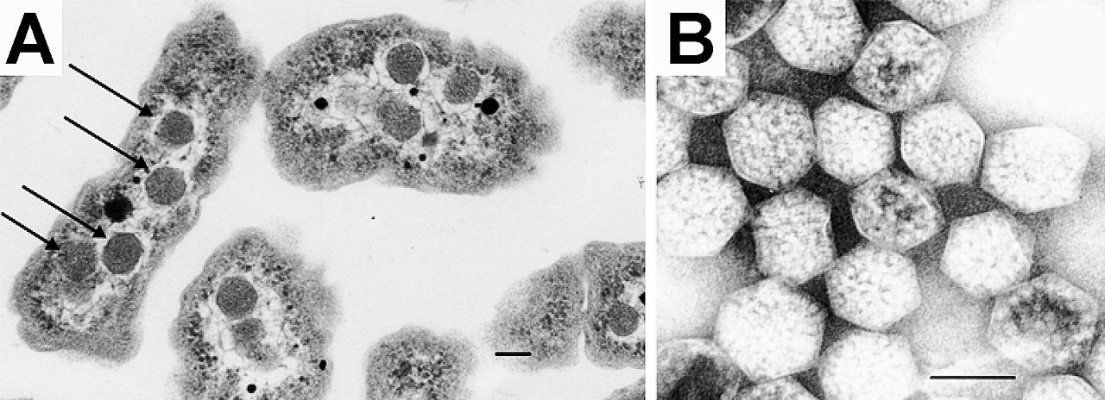

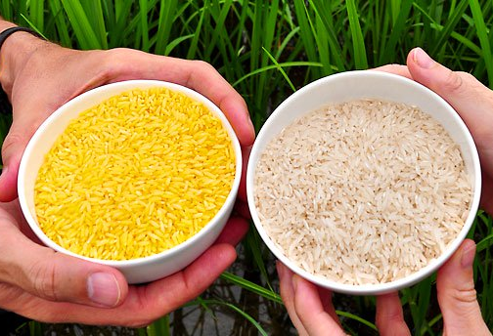
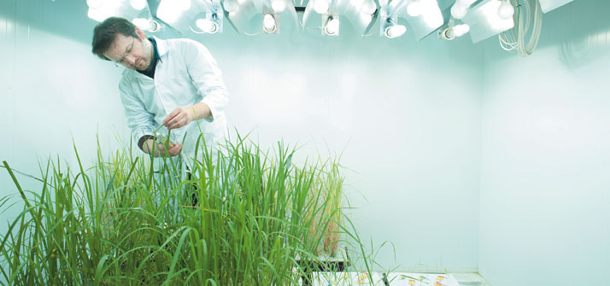
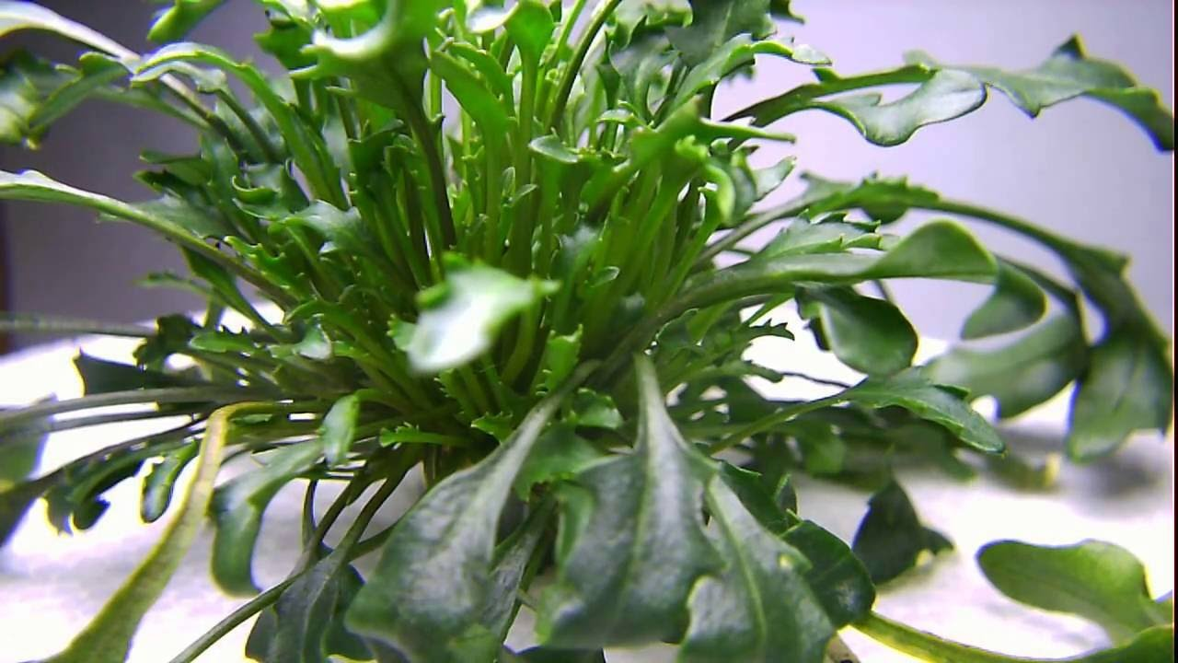

Food security - biotechnology
Learning lessons form cyanobacteria
Carboxysomes
Golden Rice
C4 Rice Project
Eutrema salsugineum – salt water cress

Slide 34
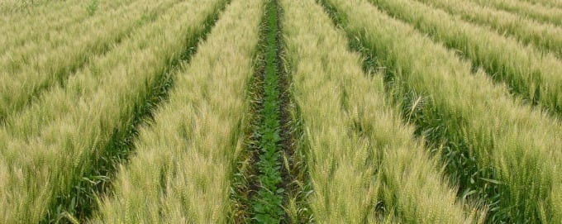
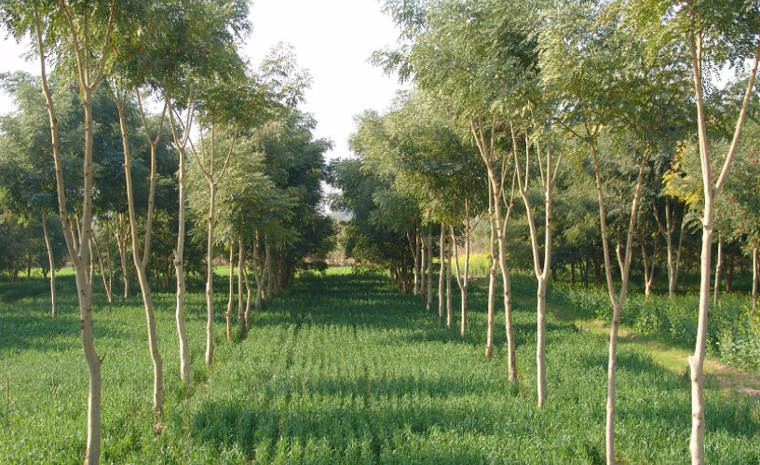


Food Security - agroecology
Agro-forestry
Intercropping
Soil management
Integrated pest management

Slide 35
Summary
Grasses evolved in the cretaceous understorey
Dominated as world got drier
Basal meristems and phytoliths
Grass drove animal evolution – teeth and guts
Co-evolution of humans and crops – espec. grasses
Further reading – “Life” Chapter 38

